Slide 1
IMS2018 Interactive Forum (IF) PowerPoint Presentation Template

Slide 2
IF PowerPoint Presentation
Your Interactive Forum (IF) presentations at IMS2018 will consist of two parts:
A printed “Poster” affixed to a “Poster Board”, aka meter-board
A PDF or PowerPoint presentation on a 55” monitor, using the provided computer
This guideline is for the second part, the PowerPoint presentation (see highlighted section below)
A single, printed summary poster discussing the participant’s research in broad strokes. This poster will be in the form of a “Penta” chart, which covers the primary motivations, insights, and results of the project. Participants are responsible for preparing, printing, and bringing their poster to their specific IF session.
A short set of PowerPoint slides that will be displayed on a 55” monitor. These slides will be tied to subject areas displayed on the Penta chart, and will allow participants to discuss their methods, results, and conclusions in more detail with forum attendees.
IMPORTANT NOTE:
IF Presenters MUST check in with the Session Chair(s) at the Check-In Area (see map on slide 10) at least 15 minutes prior to the start of their session.

Slide 3
IF PowerPoint (or PDF) Presentation
IMS2018 will provide each IF Presenter the option to provide additional details of their work, as a PowerPoint or PDF presentation, on a 55” monitor using a computer. The monitor and computer are made available at each IF station.
This PowerPoint document is the mandatory IMS2018 IF Presentation template and includes all necessary logos and banners. The presentation must be prepared in landscape with an aspect ratio of 16:9.
The PowerPoint (or PDF) slides should refer to the five sections of the Penta chart; this reference should be included on the left-hand side of each slide (see examples in the following slides of this template). The presenter/author can use the slides to provide detailed information about his or her research.
The Presenter/author may use as many slides as they would like, but there must be at least one slide per section of the Penta chart. Slides 4-9 of this template are provided as an example, but more slides can be used as needed.
IMPORTANT NOTE: IMS intends to make the IF presentations available to the IMS attendees as PDF down-loads, a week after and up to 60 days from the conclusion of the IMS Microwave Week. However, the down-loadable presentations are restricted to only those that have the necessary permissions and authorizations from the presenter/author(s) institutions and sponsors for such dissemination. The presenter/author(s) are SOLELY responsible to seek and secure such permissions and authorization prior to the submission by the 30 May 2018 deadline. This includes securing, as applicable, all ITAR and other governmental permissions. The IEEE, MTT-S, and/or IMS2018 will neither assume nor bear ANY responsibility for materials submitted without appropriate approvals or clearances, and will make NO attempt to retract, rescind, or redact the submitted materials.
Please refer to the detailed instructions at the IMS website on the preparation and submission of the IF presentations.

Slide 4
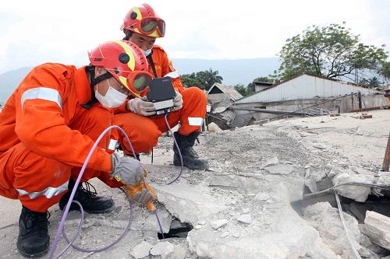
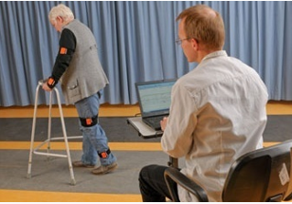
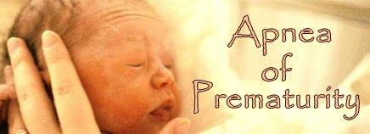
Development of a Reconfigurable Low Cost Multi-Mode Radar System for Contactless Vital Signs Detection
F. Quaiyum, L. Ren, S. Nahar, F. Foroughian, A. E. Fathy
Example
Contactless Vital Signs Detection
Essential in rescue operations, continuous monitoring of elderly people and for vital sign detection of infants/persons with sensitive skin
In many such applications, simultaneous capability of accurate vital signs detection and localization capabilities are desired
Multi-Mode Radars
Why we need it?
Combination of features of different types of Radars required for high performance in all possible scenarios in an application
Example: High frequency SFCW for short range heart rate detection, CW for long range vital signs
What has been done before?
FMCW + UWB Radar for Automotive applications (Pyo et. al.)
Simultaneous generation of SAR & GMTI waveform for airborne target detection (Kapfer et. al.)
Use combination of Envelope detector, Doppler Radar and SFCW Radar for automatic target classification (Briones et. al.)
What are the problems of the traditional approach?
STATUS QUO
Bulky | Expensive | Difficult to Control

Slide 5
Development of a Reconfigurable Low Cost Multi-Mode Radar System for Contactless Vital Signs Detection
F. Quaiyum, L. Ren, S. Nahar, F. Foroughian, A. E. Fathy
Example
Multi-Mode Operation with Reconfigurability
UWB Mode
Short-range SAR operation
Center frequency shifting for higher sensitivity
CW Mode Operation
Long range remote triage
Interferometry functionality using dual CW operation
CW Radar
+
UWB Radar
Hybrid Radar
Features:
Multi-Mode Operation:
Long/short range
Higher sensitivity
Easy Controlling Scheme
Resource sharing
Low cost and fewer components
NEW INSIGHTS

Slide 6
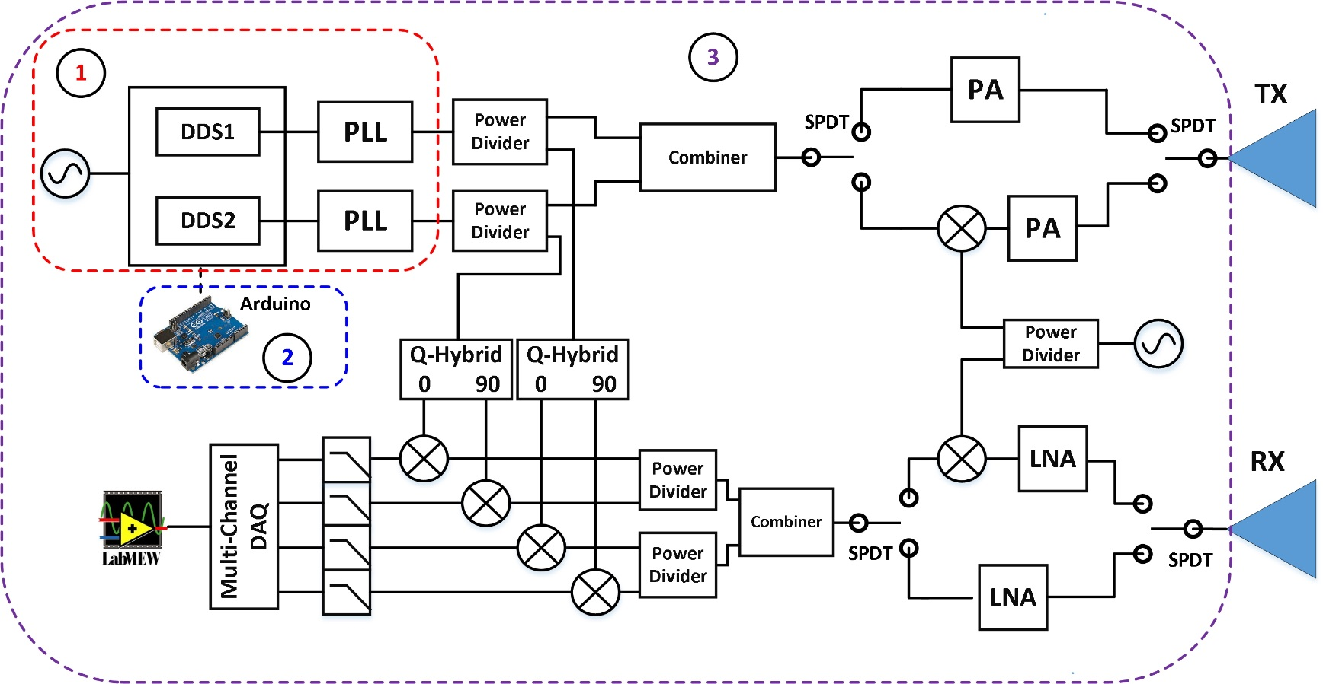
Development of a Reconfigurable Low Cost Multi-Mode Radar System for Contactless Vital Signs Detection
By F. Quaiyum et al.
Example
The transceiver is mainly composed of three parts:
Waveform Generator
Two channel DDS board where each channel can be independently configured
Capable of providing either a CW signal or SFCW signal
Microcontroller
Configures the waveform generator to perform in CW or in SFCW mode
Controls the SPDT switches enabling center frequency reconfiguration
Microwave Front End
Consisting of the Amplifiers, Mixers, Power Dividers and Antennas
DESCRIPTION
Block diagram of the proposed Multi-Mode Radar showing the (1) Waveform Generator, (2) Microcontroller and (3) Microwave Front End

Slide 7
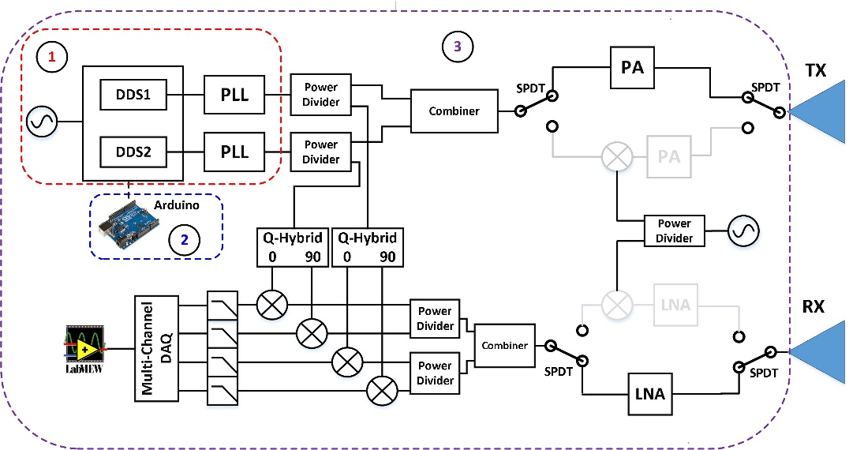
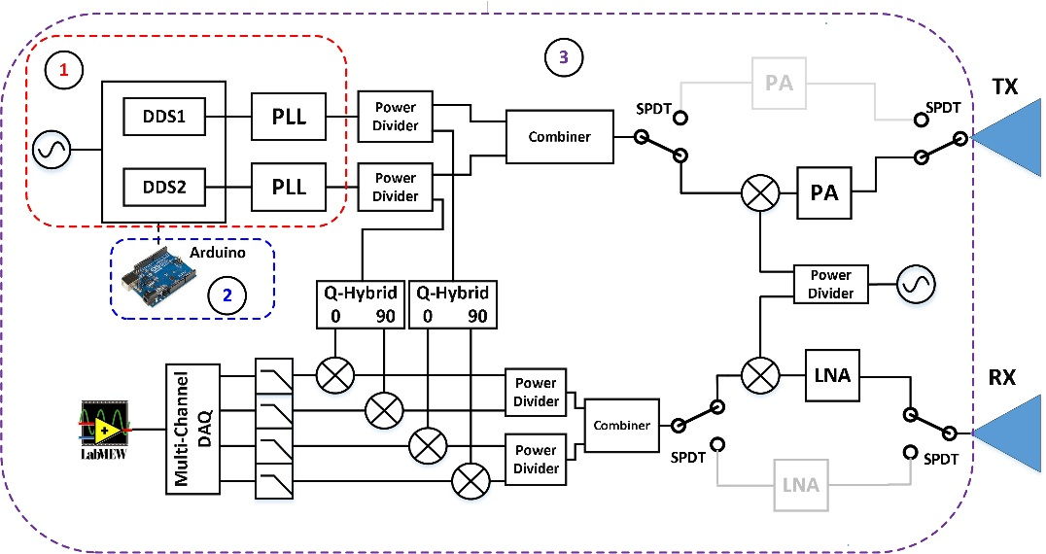
Development of a Reconfigurable Low Cost Multi-Mode Radar System for Contactless Vital Signs Detection
By F. Quaiyum et al.
Lower band SFCW (2-4 GHz)
Example
CW
DESCRIPTION
Higher band SFCW (7-9 GHz)
Different Modes of Operation Showing Spectrum and Signal Flow Path

Slide 8
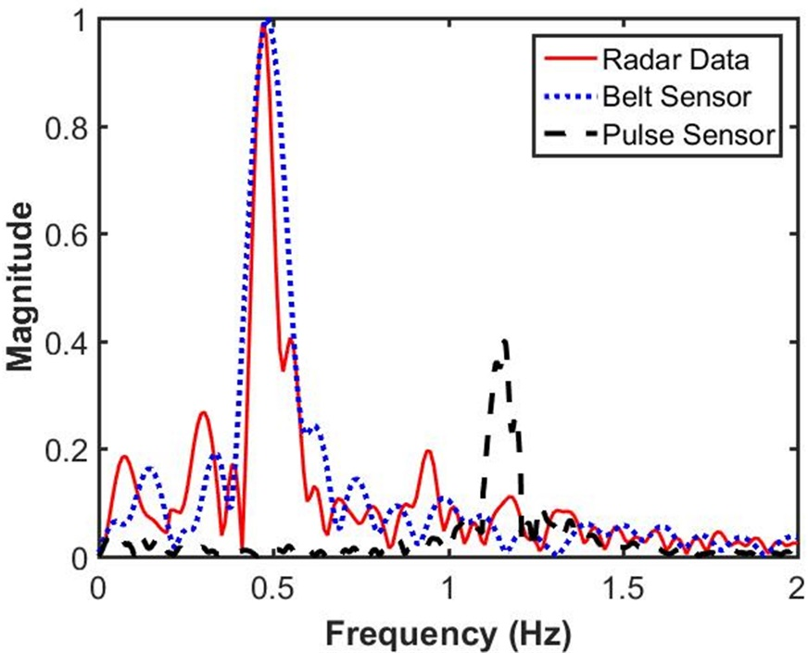
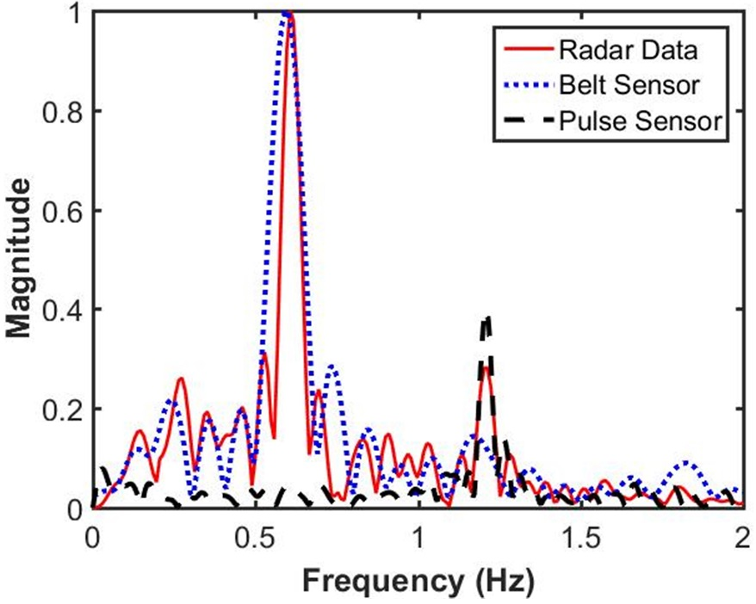
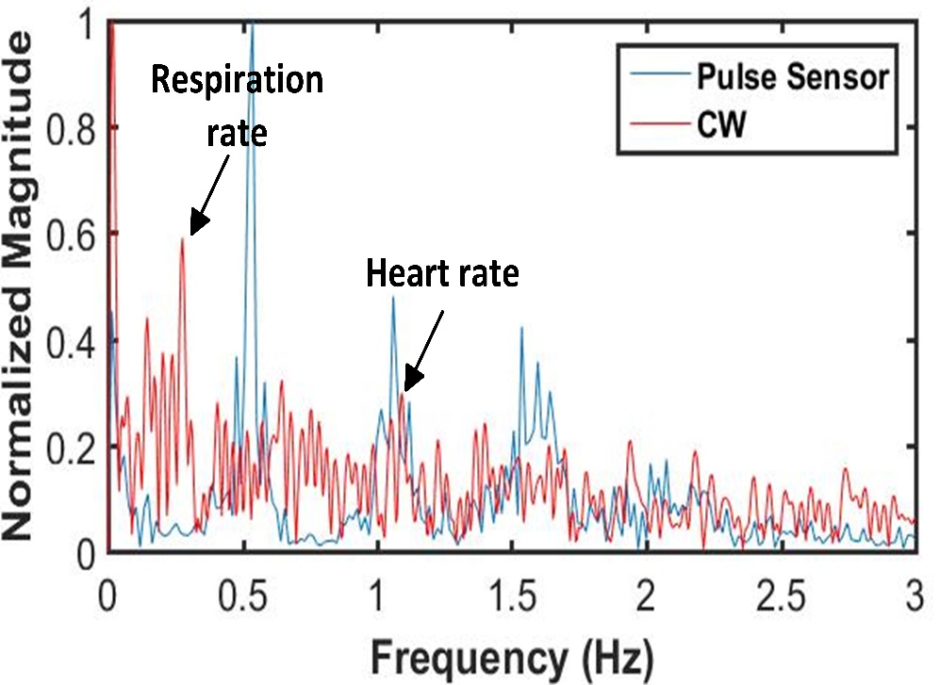
Development of a Reconfigurable Low Cost Multi-Mode Radar System for Contactless Vital Signs Detection
F. Quaiyum, L. Ren, S. Nahar, F. Foroughian, A. E. Fathy
Example
UWB Mode
Lower Band (2-4 GHz) SFCW Operation
Lower sensitivity
Cannot always accurately detect heart rate
Application:
Short range through wall respiration detection
Higher Band (7-9 GHz) SFCW Operation
Higher sensitivity
Accurate detection of heart rate
Application:
Short range vital signs detection
High resolution imaging
CW Mode
Vital sings detection for >15m range
Capable of interferometry functionality using dual CW frequency
QUANTITATIVE IMPACT

Slide 9
Development of a Reconfigurable Low Cost Multi-Mode Radar System for Contactless Vital Signs Detection
F. Quaiyum, L. Ren, S. Nahar, F. Foroughian, A. E. Fathy
Example
Multi-Mode Radar System featuring:
Minimal Size, Weight, and Power (SWAP) capable of high-resolution, and high-quality imaging
Low cost due to the sharing of components
Totally controlled by a microcontroller
Featuring UWB and CW operation:
SFCW operation with reconfigurable center frequency
Can be reconfigured to any higher frequency with proper up/down-converting components
The SFCW signal generation is always 2-4GHz, therefore no high frequency PLL/DDS board required
Single and dual CW frequency
PROPOSED CONCEPT GOAL

Slide 10
Interactive Forum Layout
Interactive Forum Session
IF1 represents TUIF1, WEIF1 and THIF
Interactive Forum Session
IF2 represents WEIF2
IF1-1
IF1-2
IF1-21
IF2-1
IF2-2
IF2-21
IF1-4
IF1-3
IF1-22
IF2-4
IF2-3
IF2-22
IF1-20
IF1-19
IF2-20
IF2-19
IF1-17
IF1-18
IF2-17
IF2-18
IF1-5
IF1-6
IF1-23
IF2-5
IF2-6
IF2-23
IF1-8
IF1-7
IF1-24
IF2-8
IF2-7
IF2-24
IF1-16
IF1-15
IF2-16
IF2-15
IF1-13
IF1-14
IF2-13
IF2-14
IF1-9
IF1-10
IF1-25
IF2-9
IF2-10
IF2-25
IF1-12
IF1-11
Check-In
IF2-12
IF2-11
Check-In
IMPORTANT NOTE: Presenters must check in, at the Check-In Area, at least 15 minutes prior to the start of their session.

